Slide 1


Slide 2


DMU
Hacking Society
Intro to Hash Cracking

Slide 3




DMUHACKERS
D0nt d0 1ll3gal sh1t
please..

Slide 4
What is a Hash?
DMU HACKERS
A hash is a fixed-size string of characters that uniquely represents data. It’s created by running the data through a hashing algorithm like MD5, SHA-1 or SHA-256
In other words: “ A hash is a digital fingerprint, it uniquely identifies data, but you cannot reverse it to get the original” ← Genuinely magic XD

Slide 5
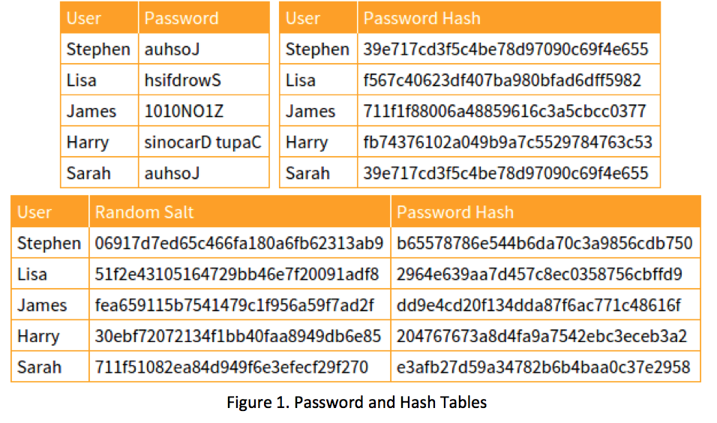
What is a Hash?
DMU HACKERS

Slide 6
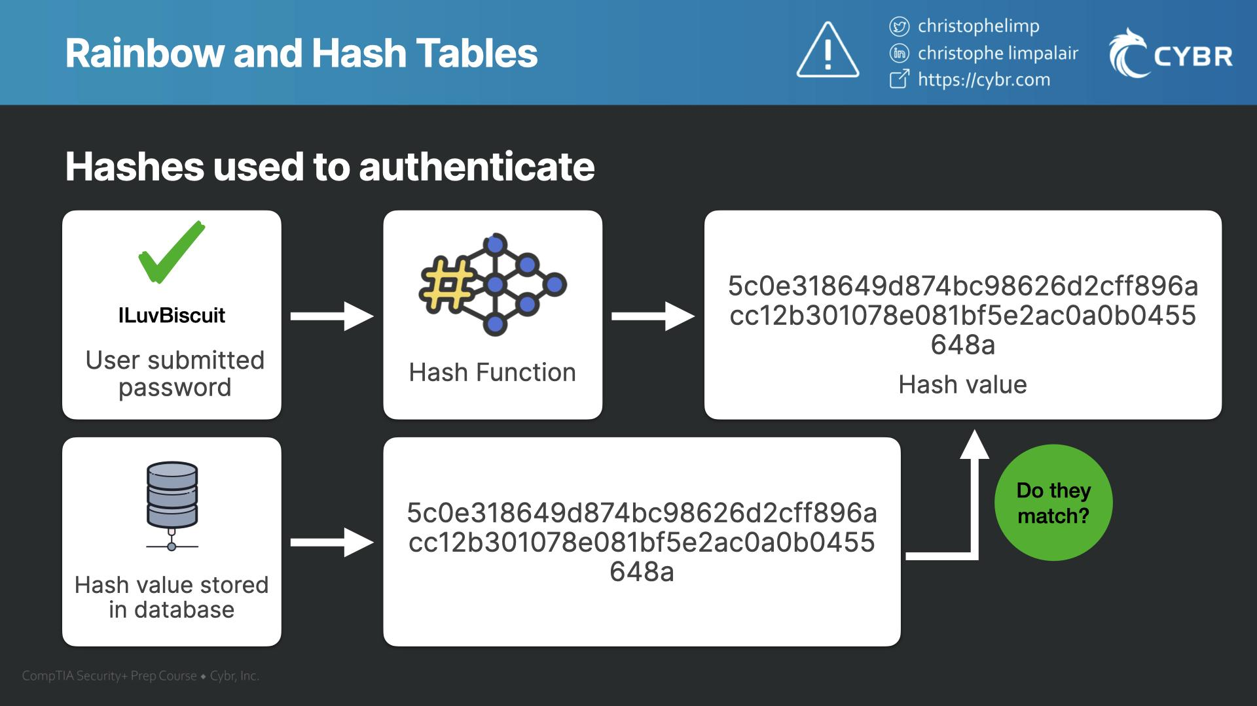
What is a Hash?
DMU HACKERS

Slide 7
How are hashes broken?
DMU HACKERS
Dictionary Attacks
Try every password in a wordlist (rockyou.txt) and hash each one
Compare the result to the target hash
Fast, effective against common passwords…
If your password is on a breach list… CHANGE IT IMMEDIATELY, someone somewhere will be cracking it (trust me…)
Haveibeenpwned.com
breachdirectory.org

Slide 8
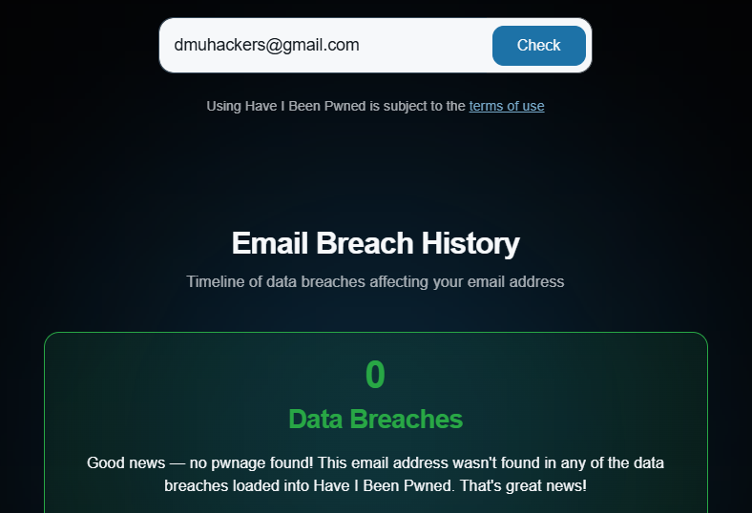
How are hashes broken?

Slide 9
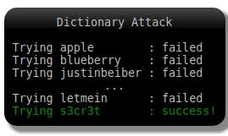
How are hashes broken?
DMU HACKERS

Slide 10
How are hashes broken?
DMU HACKERS
Brute Force Attacks (similar to dictionary attacks)
Try every possible combination of chars until a match is found
Time consuming, especially with long or complex passwords
Example: a 5-letter password = 26^5 = 11,881,376 tries (maximum)

Slide 11
How are hashes broken?
DMU HACKERS
Rainbow Tables
Precomputed tables of hashes and their original inputs
Trade time for storage
Defeated by salting (adding random data before hashing)

Slide 12
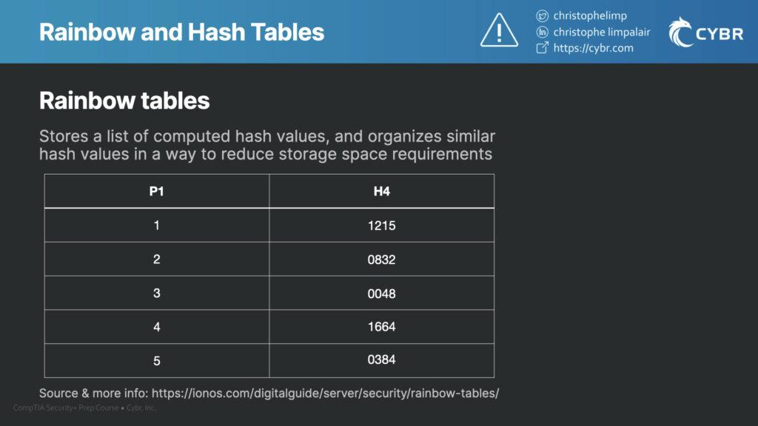
How are hashes broken?
DMU HACKERS

Slide 13
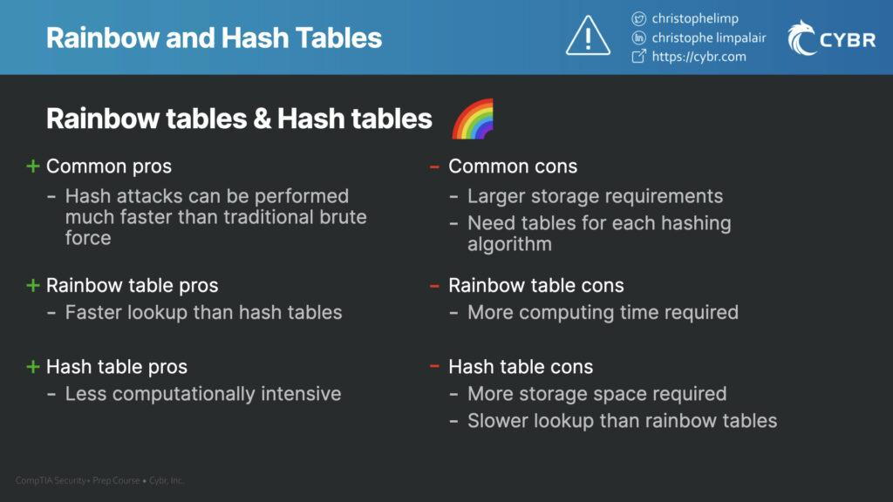
How are hashes broken?
DMU HACKERS

Slide 14
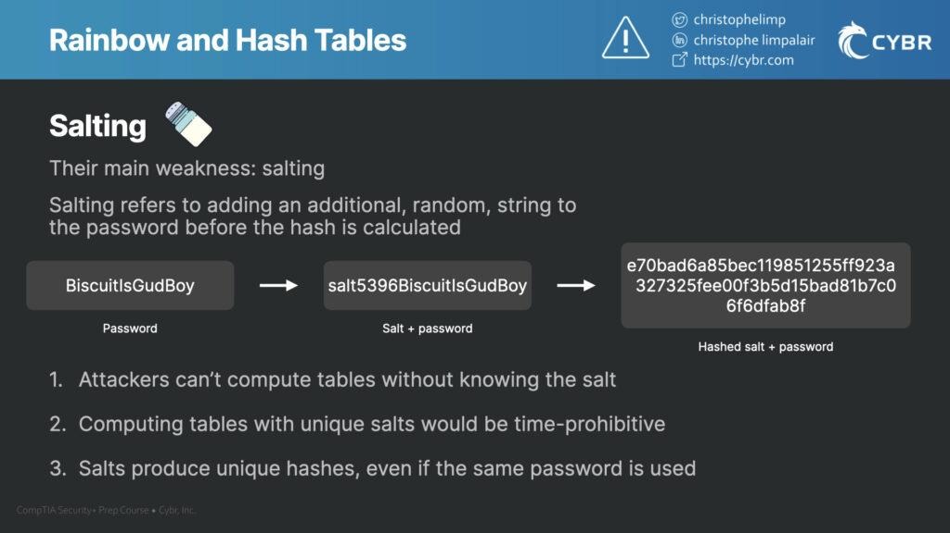
How are hashes broken?
DMU HACKERS

Slide 15
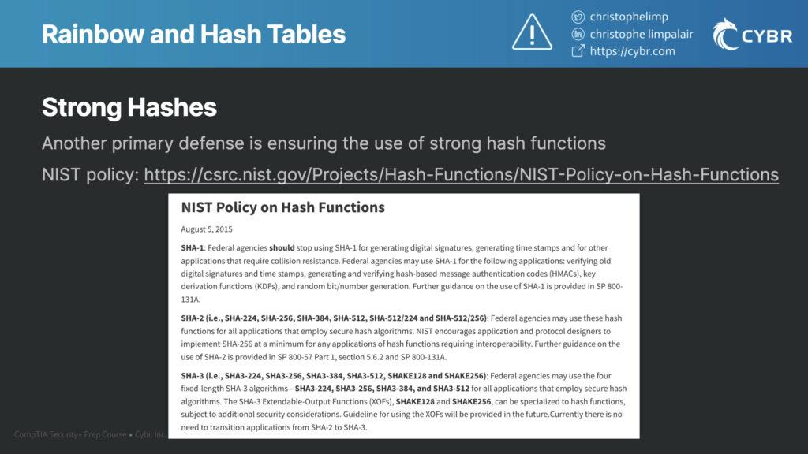
How are hashes broken?
DMU HACKERS

Slide 16
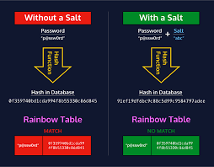
Rainbow Tables and Salting
DMU HACKERS

Slide 17
How are hashes broken?
DMU HACKERS
Rule-Based Attacks
Modify dictionary words with common patterns
E.g. Password → P@ssw0rd!
Based on human tendencies and password leaks
Utilise OSINT!!!!!
Tools like John the Ripper and Hashcat do this automatically

Slide 18
How are hashes broken?
DMU HACKERS
Hash Collisions (weak algorithms)
Two different inputs produce the same hash
Exploitable in MD5, SHA-1
Dangerous for digital signatures and certificates

Slide 19
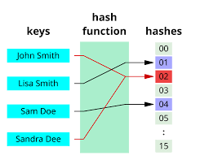
Collisions in hashing
DMU HACKERS

Slide 20
Overview of Hashing Algorithms
DMU HACKERS
Algorithm | Length | Usage | Status
MD5 | 128 | Checksums | BROKEN (coll)
SHA-1 | 160 | Certificates, Git | BROKEN (coll)
SHA-256 | 256 | Modern Security, File integrity | SECURE
NTLM | 128 | Windows Auth | WEAK
bcrypt | Variable | Password Hashing | SECURE
SHA-3 | 256+ | Modern Crypto Hashing | SECURE (LONG)

Slide 21
Identifying a hash
DMU HACKERS
We have a hash but how do we know what to do with it?
Length of hash… (Bits/Chars)
Starts with: i.e. $2a$ or $2b$...
Uppercase/Lowercase
MD5 = 5f4dcc3b5aa765d61d8327deb882cf99
LM Hash = E52CAC67419A9A224A3B108F3FA6CB6D
SHA-1 = b89eaac7e61417341b710b727768294d0e6a277b

Slide 22
Identifying a hash
DMU HACKERS
Tools to aid us in this process…
Online
https://hashes.com/en/tools/hash_identifier
https://www.tunnelsup.com/hash-analyzer/
CLI (Kali VM)
hash-identifier
name-that-hash
Python-based:
python3 hashid.py
python3 name-that-hash.py

Slide 23
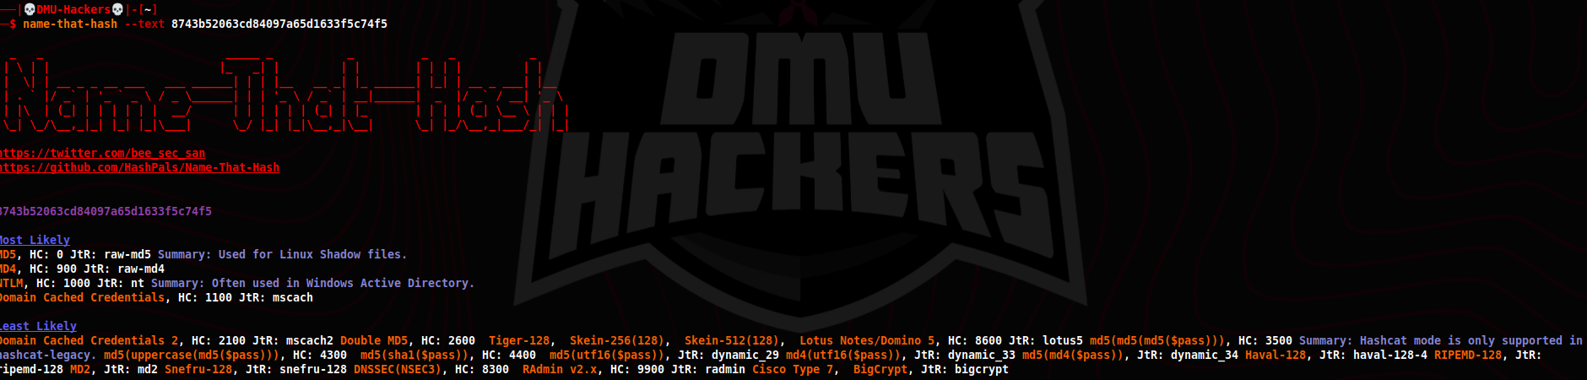
name-that-hash
DMU HACKERS
sudo apt install name-that-hash
name-that-hash --text <hash>

Slide 24
https://crackstation.net/
DMU HACKERS
Crackstation
Crackstation is an online tool that uses massive precomputed hash tables to crack common hashes like MD5, SHA-1, and SHA-256
It uses a 20GB table containing over 1.5 Billion entries
Crackstation accepts input as:
One hash per line in the web interface

Slide 25
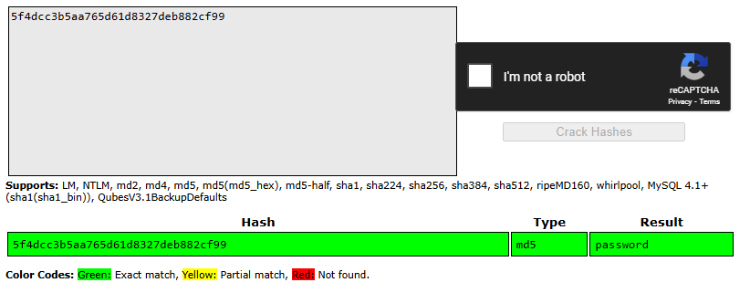
https://crackstation.net/
DMU HACKERS

Slide 26
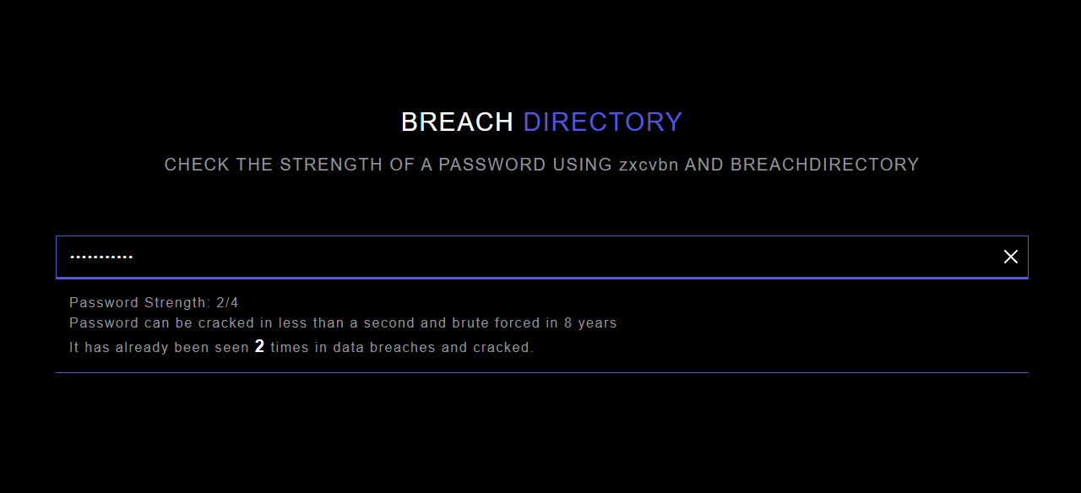
https://breachdirectory.org/
DMU HACKERS

Slide 27

hashcat
DMU HACKERS
Hashcat is the world's fastest and most advanced “password recovery” tool, we use it to crack hashes utilising CPUs and GPUs !
Open source
Pre-installed on Kali
Supports 300+ hash types
GPU acceleration (parallel threading) = FAST cracking & warm PC
Hashcat also now has an auto detect feature!!
The rules for hashcat can be found at /usr/share/hashcat/rules/

Slide 28
hashcat
DMU HACKERS
Basic command structure…
hashcat -m <hash_type> -a <attack_mode> <hash_file> <wordlist>
Hash format = ???
Attack Mode = ??? wordlist = /usr/share/wordlists/rockyou.txt
At

Slide 29
hashcat
DMU HACKERS
Example modes for hashcat:
0 = MD5
1000 = NTLM
(use hashcat --help to list modes)
Attack Modes:
0 = Dictionary Attack
3 = Brute Force Attack
At

Slide 30
Example hashcat command…
DMU HACKERS
Hashcat -m 0 -a 0 hash.txt /usr/share/wordlists/rockyou.txt

Slide 31

John (the ripper)
DMU HACKERS
John is a fast, powerful offline password cracker. It supports a wide range of hashes and formats…
Installed by default on Kali (john)
Auto detects hash types
Uses dict, brute and incremental attacks
Common uses of mr jonathan el ripperio:
Cracking /etc/shadow hashes (linux user creds storage location!)
Cracking NTLM hashes (tasty)
CTFs!!!!
Cracking into PDFs, encrypted ZIPs (zip2john module)
At

Slide 32
John (the ripper)
DMU HACKERS
Useful tools within john (some)
Zip2john
Converts ZIP files into a format ready to crack
pdf2john.py
Extract password hash from encrypted PDFs
unshadow
Merges /etc/passwd and /etc/shadow
At

Slide 33
John (the ripper)
DMU HACKERS
john <hash_file> --wordlist=<path_to_wordlist>
At

Slide 34

GradCracker
DMU HACKERS
At

Slide 35
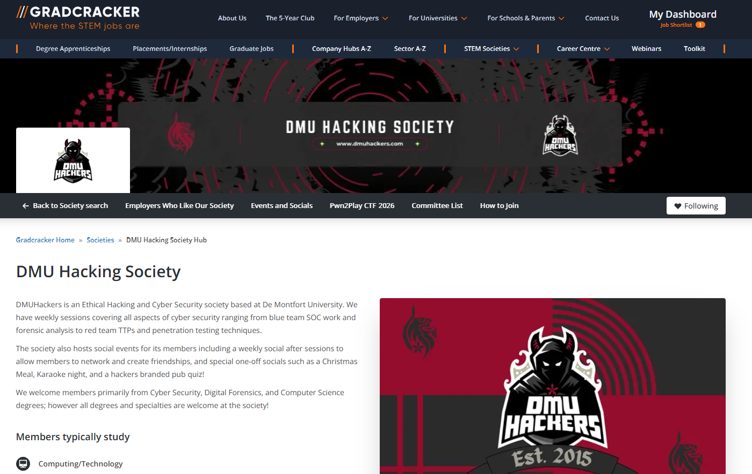
GradCracker
DMU HACKERS
At

Slide 36

GradCracker

Slide 37
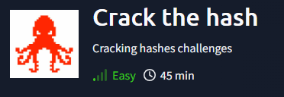
Practical
https://tryhackme.com/room/crackthehash

